Slide 1


MSBA 315
Volume 101
Wednesday, May 8, 2024
ARTICLE CLASSIFICATION PROJECT
TEAM GETS A+
ON ARTICLE CLASSIFICATION PROJECT
ALI ANNAN, KINAN MOURAD, RITA SALLOUM, SASHA NASSER, ROMANOS RIZK

Slide 2
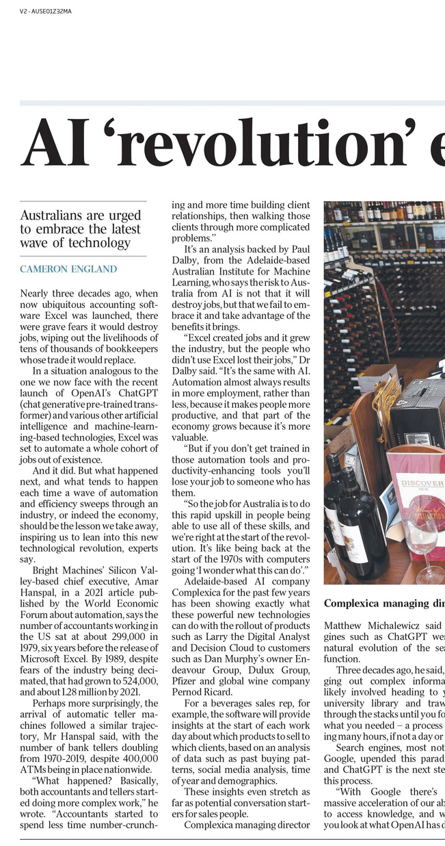
BACKGROUND
MSBA 315
Wednesday, May 8, 2024
News Industry Shift
NY Times Dataset: Over 2.1 million
Project Goal: Accurate
classification of articles
into sections
Project Impact: Improves relevance and accessibility of news content.
page 01

Slide 3

MSBA 315
Volume 101
Wednesday, May 8, 2024
PROBLEM
Rapid Increase in Content Volume: The shift to digital has significantly increased the volume of articles produced daily, creating challenges in managing and categorizing vast amounts of textual data.
Need for Efficient Article Categorization: Accurate categorization is essential to enhance discoverability and deliver personalized content, impacting reader engagement and retention.
Limitations of Traditional Models: Existing traditional classification models struggle to handle the complexity and scale of data, necessitating the exploration of advanced machine learning and deep learning techniques.
page 02

Slide 4

OBJECTIVES
MSBA 315
Wednesday, May 8, 2024
Enhance Text Classification: Implement and optimize advanced machine learning models to improve the accuracy of article categorization.
Increase Content Personalization: Leverage classification insights to tailor content delivery, enhancing user engagement and satisfaction.
Expand Analytical Capabilities: Develop a framework that can be adapted for real-time analytics and trend identification within large datasets.
page 03

Slide 5
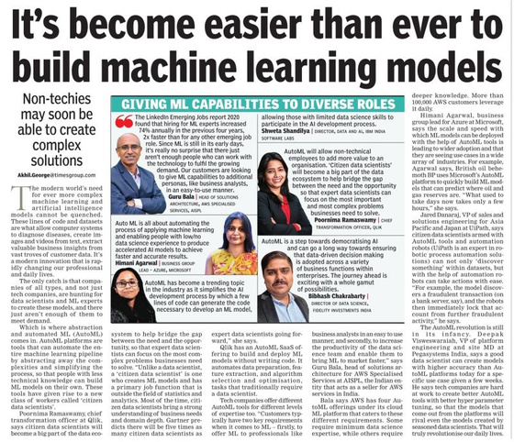
RELATED WORK DISCUSSION
MSBA 315
Wednesday, May 8, 2024
Dien et al. (2019):
Focused on automated classification using SVM and kNN.
Highlighted the importance of preprocessing and TF-IDF
Palanivinayagam et al. (2023):
Systematic review of text classification over 20 years.
Identified key challenges like feature selection and overfitting.
Aum & Choe (2021):
Developed an automated article classification model using BERT.
Improved efficiency in systematic review procedures with the srBERT model.
page 04

Slide 6
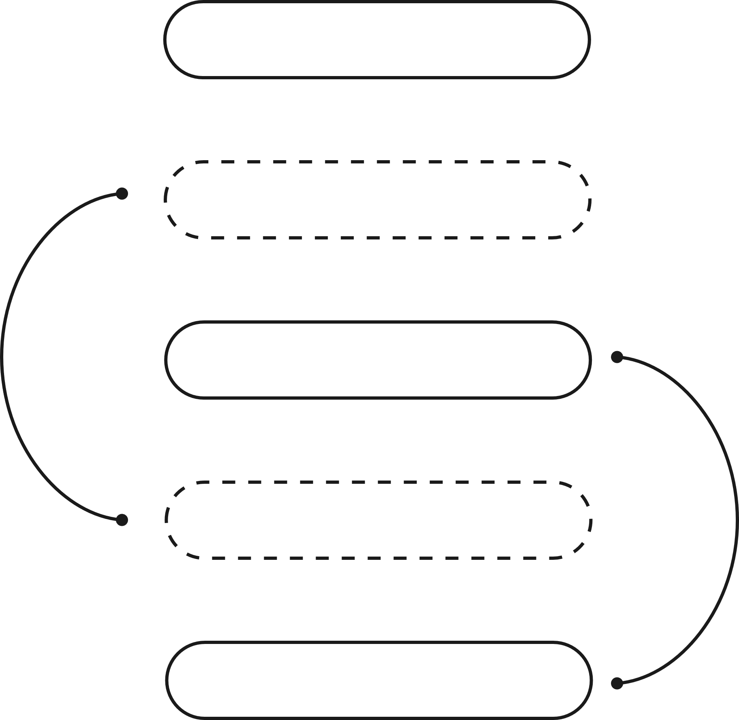
MSBA 315
Volume 101
Wednesday, May 8, 2024
SUBSETTING
EDA
PROPOSED METHODS
PREPROCESSING
FEATURE ENGINEERING
MODELING
page 05

Slide 7
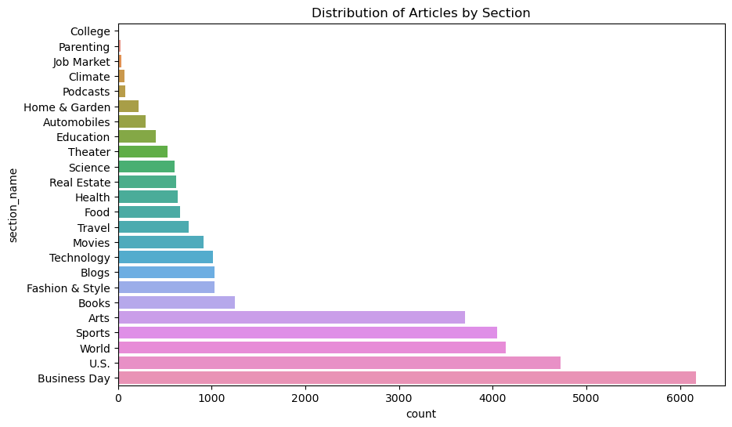
EDA
MSBA 315
Wednesday, May 8, 2024
page 06

Slide 8
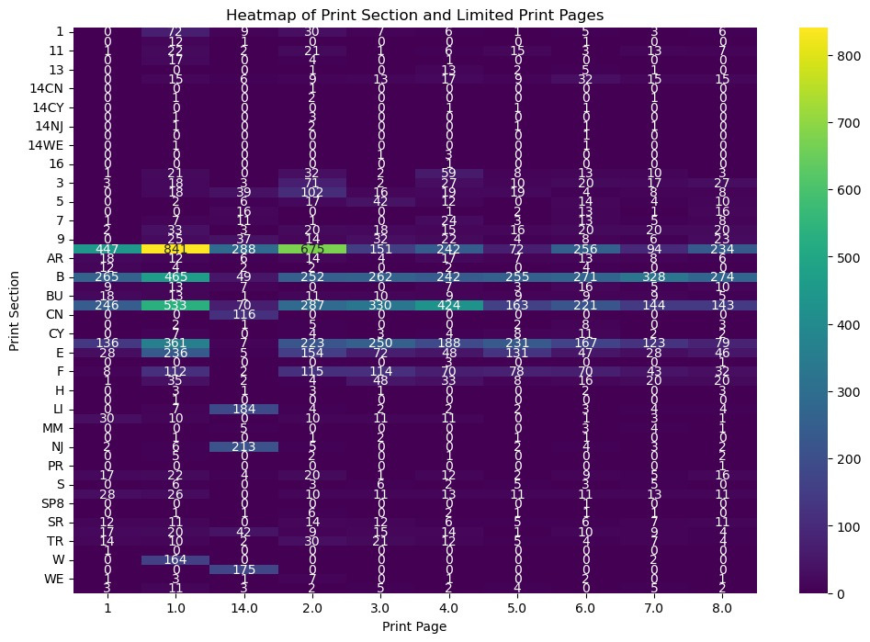
EDA
MSBA 315
Wednesday, May 8, 2024
page 07

Slide 9


PREPROCESSING & FEATURE ENGINEERING
MSBA 315
Wednesday, May 8, 2024
Dropped Irrelevant Columns
Extracted Main Dictionary
Selected 24 Section Names
Combined Columns
Dropped Null Values
Transformed Key Words to Strings
Split 70-30
Porter Stemmer, identified tokens and stemmed them, created columns with combined text
Removed Special Characters, numeric values, extra white space, and stop words
page 08

Slide 10

PREPROCESSING & FEATURE ENGINEERING
MSBA 315
Wednesday, May 8, 2024
Converted Text Columns to Lower case
Converted TF-IDF Matrix to data frame, then concatenated with original data frame
Define X-Train Y Train X-Test Y-Test
Filter out non numeric columns and filter features
Label Encoder and transform section name, creating new column and drop initial one.
page 09

Slide 11
MSBA 315
Volume 101
Wednesday, May 8, 2024
MODELING
page 10

Slide 12
KNN
MSBA 315
Wednesday, May 8, 2024
BASE
Accuracy = 62%
Literature
Accuracy = 63%
Grid Search
Accuracy = 66%
page 11

Slide 13
Random Forest
MSBA 315
Wednesday, May 8, 2024
BASE
Accuracy = 71%
Literature
Accuracy = 72.16%
Grid Search
Accuracy = 72.77%
page 12

Slide 14
XGBoost
MSBA 315
Wednesday, May 8, 2024
BASE
Accuracy = 71%
Literature
Accuracy = 72.5%
Grid Search
Accuracy = 72.5%
page 13

Slide 15
Logistic Regression
MSBA 315
Wednesday, May 8, 2024
BASE
Accuracy = 66%
Literature
Accuracy = 71%
Grid Search
Accuracy = 74%
page 14

Slide 16
MSBA 315
Volume 101
Wednesday, May 8, 2024
BUT
page 15

Slide 17

MSBA 315
Volume 101
Wednesday, May 8, 2024
MODELING USING NEURAL NETWORKS AND BERT
page 16

Slide 18

MSBA 315
Volume 101
Wednesday, May 8, 2024
USED BERT WITH SAME PREPROCESSING
EXCEPT
Converted TF-IDF Matrix to data frame, then concatenated with original data frame
Label Encoder and transform section name, creating new column and drop initial one.
page 17

Slide 19



FOR BERT SPECIFICALLY
MSBA 315
Wednesday, May 8, 2024
Tokenization and Encoding with BERT
BERT Model Initialization
Accuracy = 88.6%
Label Conversion and Mapping:
The categorical labels are converted into numerical format and mapped to their respective indices
page 18

Slide 20
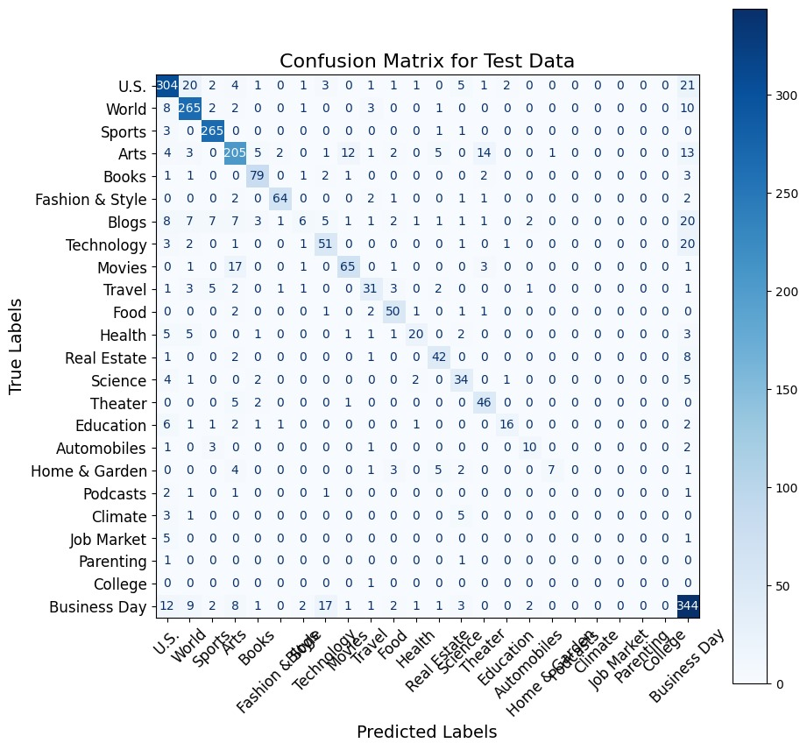
CONFUSION MATRIX
MSBA 315
Wednesday, May 8, 2024
page 19

Slide 21
ERROR ANALYSIS
MSBA 315
Wednesday, May 8, 2024
The text is about former President Bill Clinton being close to securing a deal to publish his memoirs, potentially receiving an advance payment that surpasses that of his wife, Hillary Clinton.
It mentions personal and political contexts, such as the Monica Lewinsky scandal and the Whitewater investigation.
True Label: Business Day - This label suggests that the content is considered from a business or commercial perspective, emphasizing the financial and contractual aspects of the book deal.
Predicted Label: U.S. - The model classified it under a general U.S. category, which might typically cover a wide range of topics related to the United States, including politics.
This is likely due to the focus on a cultural figure rather than the business aspect of the book deal.
page 20

Slide 22

RECOMMENDATIONS
MSBA 315
Wednesday, May 8, 2024
Optimize BERT Implementation: Given BERT's superior performance, continue refining this model with adjustments to improve generalization on unseen data.
Implement Validation Phases: Reintroduce validation phases in model training to balance the trade-off between accuracy and generalization.
Develop Content Personalization Strategies: Utilize the insights from article categorization to enhance personalized content delivery systems, aiming to boost reader engagement and subscription rates.
page 21

Slide 23






THANK YOU FOR LISTENING!
Ali
Annan
Kinan Mourad
Rita
Salloum
Sasha
Nasser
Romanos Rizk

Slide 24







MSBA TEAM FINDS SOLUTION TO CLASSIFY ARTICLES
Article by Rita

